Slide 1

SoC-based Architecture for Biomedical Signal Processing
Authors: R. Gutiérrez-Rivas, A. Hernández, J. J. García, W. Marnane.
Source:2015 37th Annual International Conference of the IEEE Engineering in Medicine and Biology Society (EMBC)
Presented by:
Progga Labani Howlader
Roll:1509035

Slide 2
Overview
Background
Introduction
What is SOC Architecture
Detection of QRS complex
Implementation of QRS complex detector
Results
Conclusions
References
1

Slide 3

Background
Figure 1: Heart.
18 million were attacked due to the coronary heart disease
7.2 million are stoke problem
Human heart rate activity can be electrically recorded in the (ECG) signal
ECG reveal a number of heart disorders
2

Slide 4
Introduction
In biomedical signal processing, many algorithms focused on the noise reduction and eliminates artifacts existing in the signal.
Power consumption and computational complexity has been observed.
But SoC (System-on-Chip) architecture, based on a FPGA(Field-Programmable Gate Array)device, suitable for the implementation of biomedical signal(ECG signal)processing.
This architecture reduce number of resources , sensitivity , increase positive predictive value.
3

Slide 5
What is SOC Architecture
Based on FPGA device
Proposed for implementing ECG signal processing algorithms.
Provides a logic area for real time solution.
Allows complex control tasks.
Xilinx Zynq device used to implement
4

Slide 6
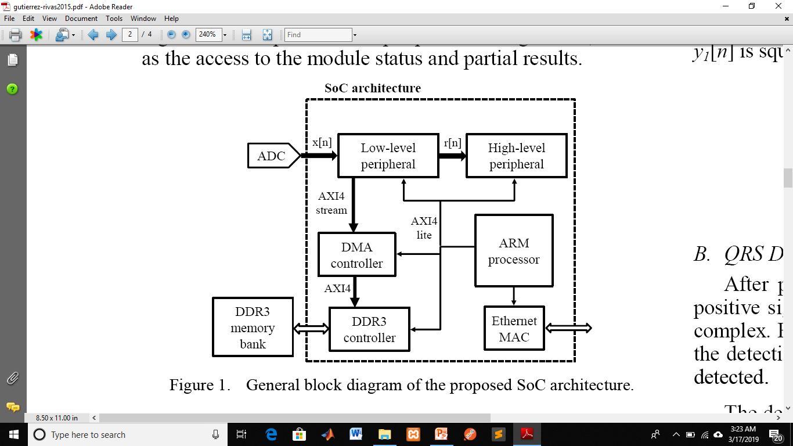
SOC Architecture(continued…)
Figure 2: General block diagram of SoC architecture
5

Slide 7
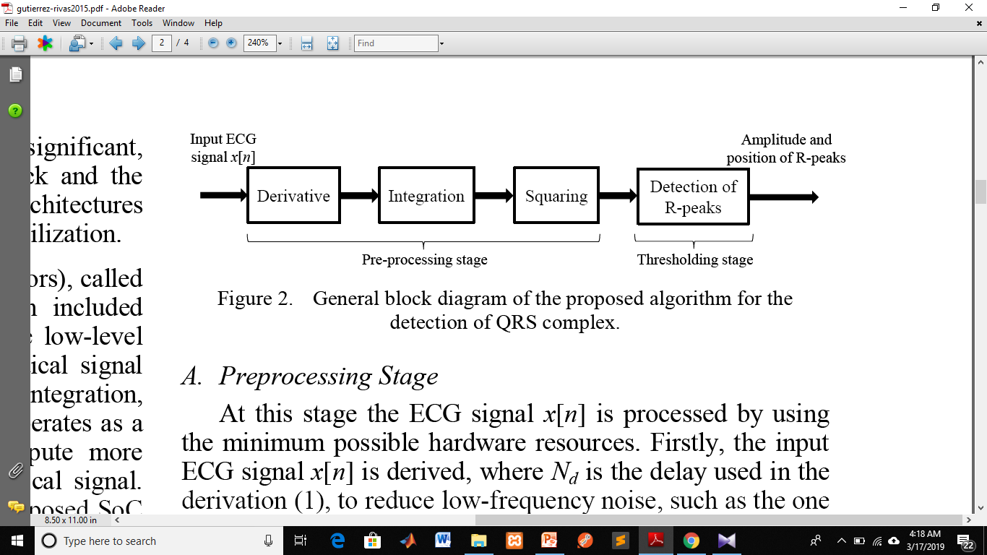
Detection of QRS Complex
Figure 3:General block diagram of the proposed algorithm for the detection of QRS complex
Implementing a detection algorithm for QRS complex in ECG signal , thus the signal processing has been validated.
6

Slide 8
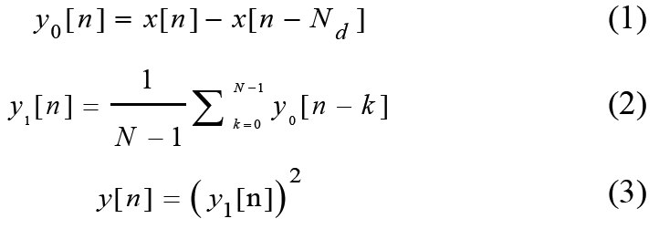
Detection of QRS Complex(continued…)
A. Pre-processing stage:
use input ECG signal [x(n)] at sampling frequency, fs=360 Hz.
This input signal consists of minimum hardware resources.
B.QRS detection stage:
based on a dynamic threshold th(n)
amplitude depends on the ECG signal amplitude
controlled by a FSM with 3 States. 7

Slide 9
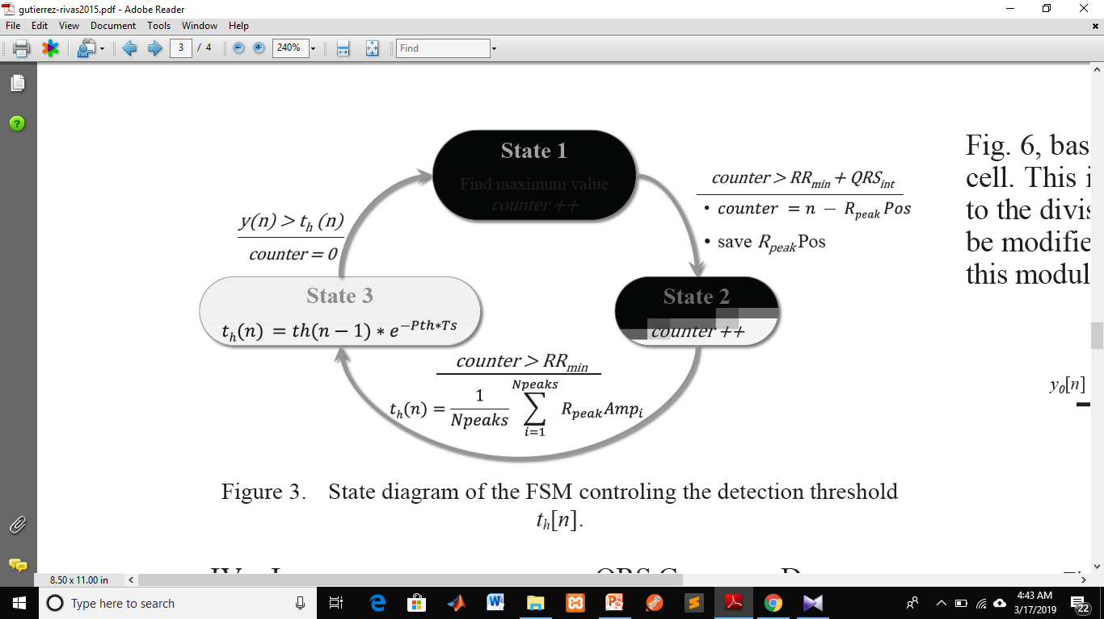
Detection of QRS Complex(continued…)
Figure 4:State diagram of the FSM controlling the detection threshold th(n)
8

Slide 10
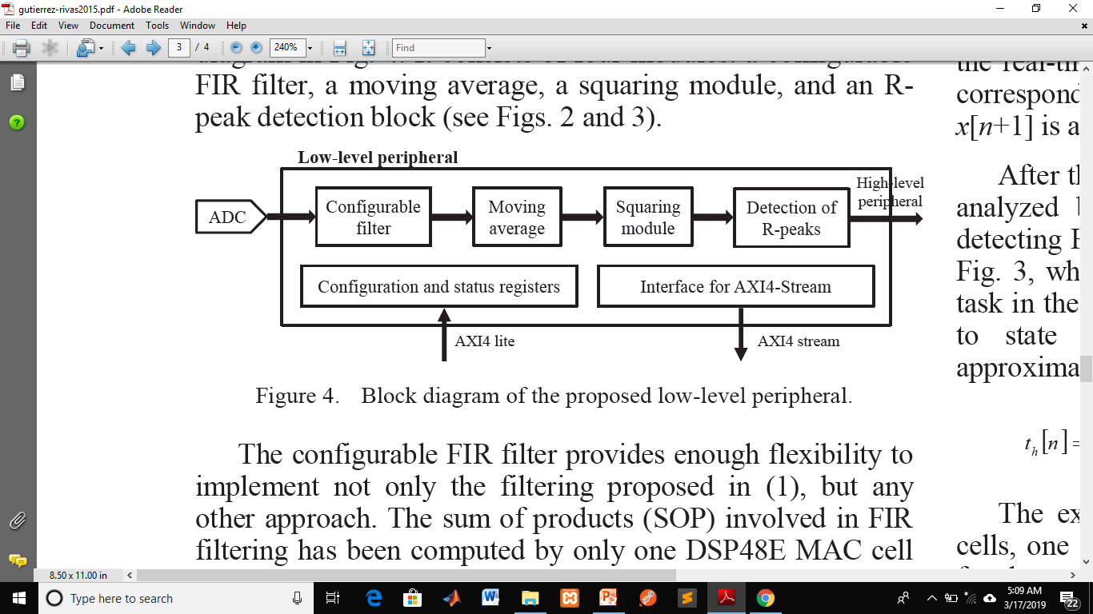
Implementation of QRS complex detector
The QRS detection stage follow this block diagram
Figure 5:Block diagram of the proposed low-level peripheral
9

Slide 11
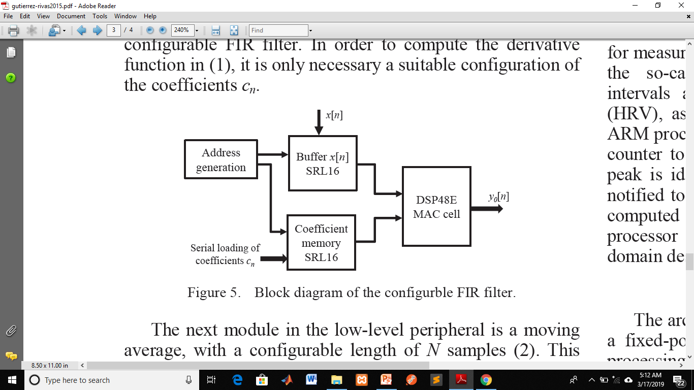
Implementation of QRS complex detector(continued…)
Configurable filter:
provide enough flexibility.
Figure 6:Block diagram of the configurable FIR filter
10

Slide 12
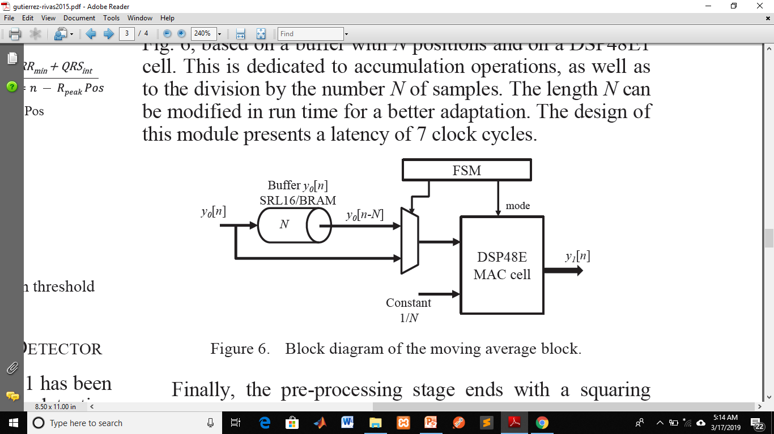
Implementation of QRS complex detector(continued…)
Moving average:
Figure 7:Block diagram of the moving average block
11

Slide 13
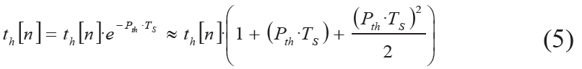
Implementation of QRS complex detector
After the pre-processing stage , the resulting signal y(n)is analyzed by a finite state machine (FSM) which is the exponential function.
12

Slide 14
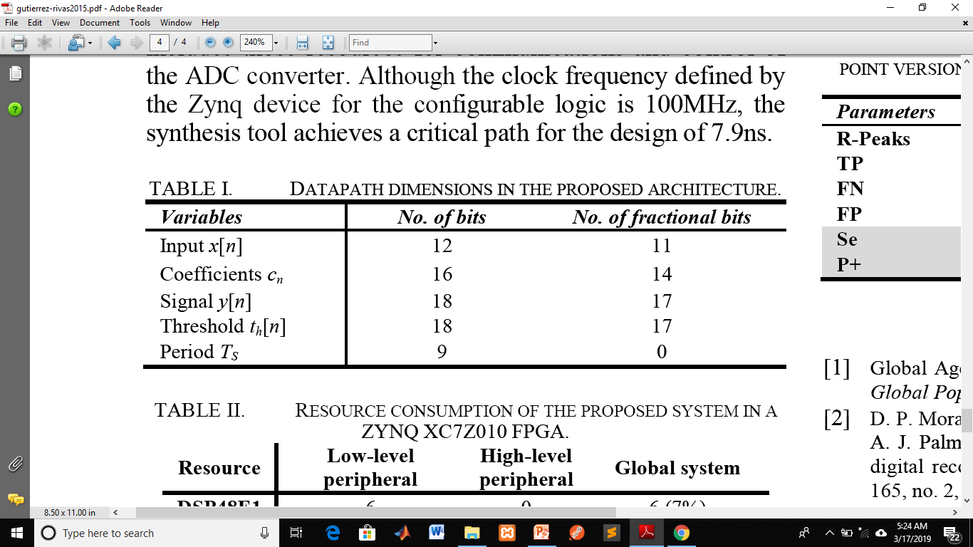
Results
This table describes the word widths defined for SOC architecture.
13

Slide 15
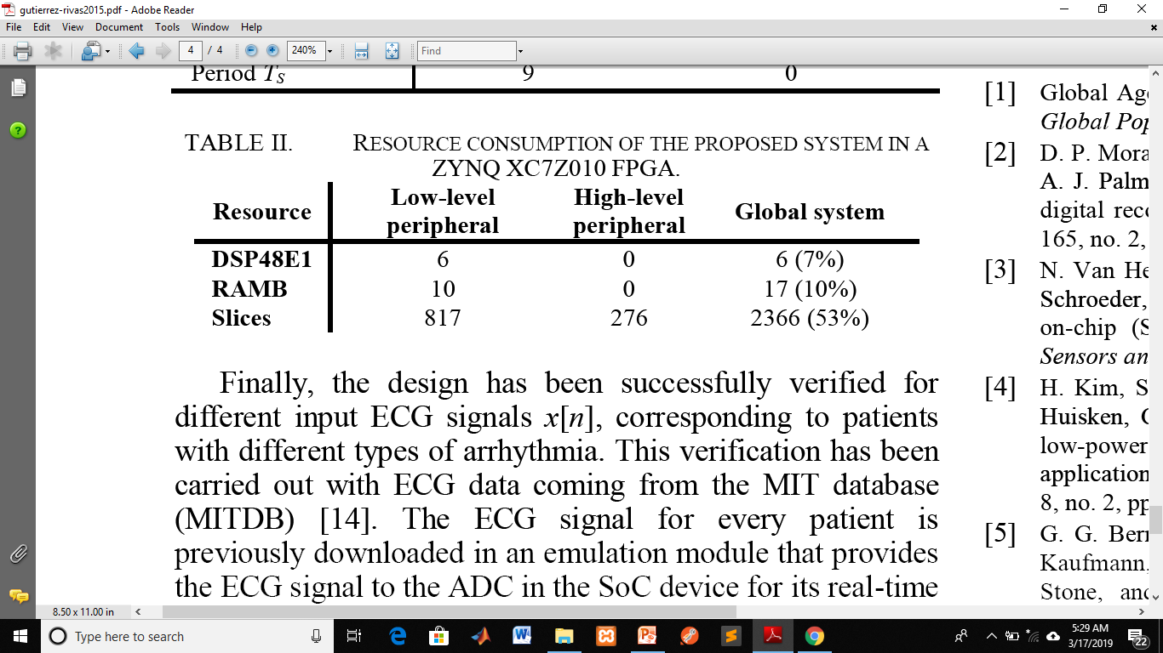
Results(continued….)
This table shows the resource consumption for the different elements in the system.
14

Slide 16
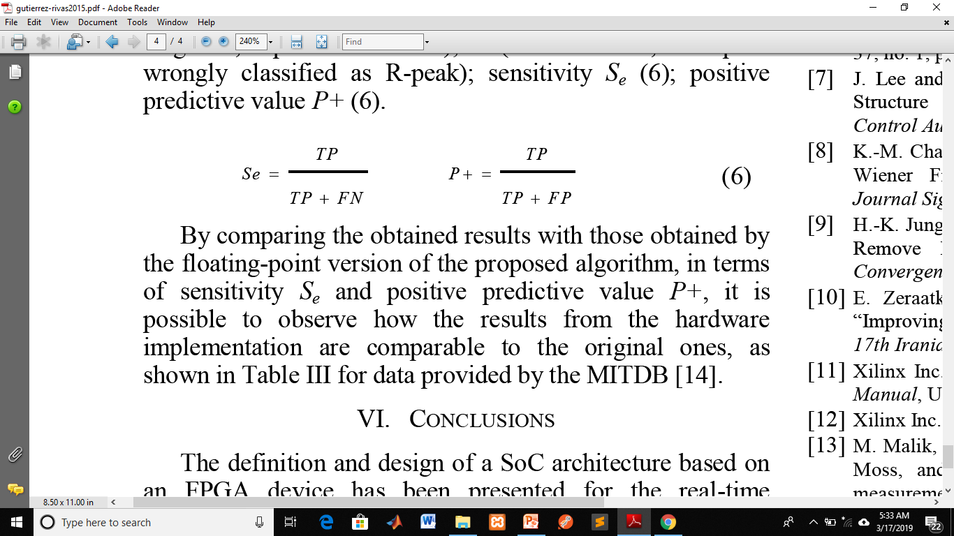
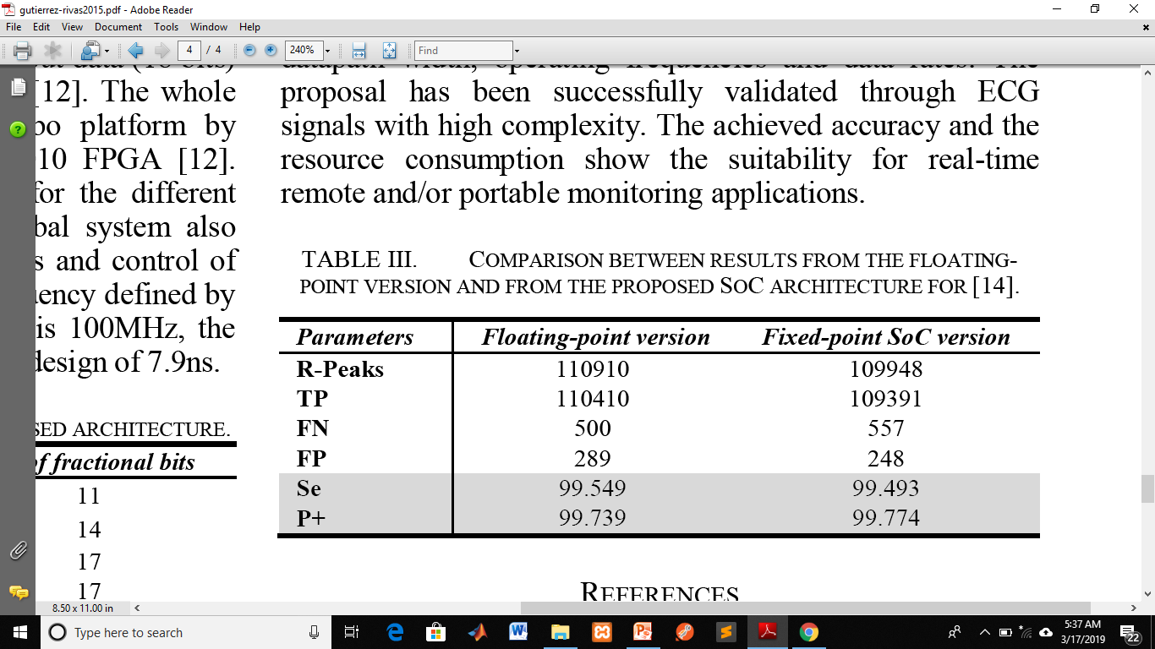
Results(continued…..)
Sensitivity and positive predictive value is
15

Slide 17
Conclusion
SoC Architecture presented for real-time implementation of biomedical signal processing algorithms.
This architecture has been validated through ECG signals with high complexity.
Accuracy and the resources consumption achieved
Suitable for real-time applications.
16

Slide 18
References
[1] Global Agenda Council on Ageing Society, World Economic Forum,Global Population Ageing : Peril or Promise?, 2011.
[2] D. P. Morales, A. García, E. Castillo, M. A. Carvajal, J. Banqueri, and A. J. Palma, “Flexible ECG acquisition system based on analog and digital reconfigurable devices”, Sensors and Actuators A Phys., vol.165, no. 2, pp. 261-270, 2011.
[3] N. Van Helleputte, J. M. Tomasik, W. Galjan, A. Mora-Sánchez, D.Schroeder, W. H. Krautschneider, and R. Puers, “A flexible systemon-chip (SoC) for biomedical signal acquisition and processing”,Sensors and Actuators A Phys., vol. 142, no. 1, pp.361-368, 2008.
[4] H. Kim, S. Kim, N. Van Helleputte, A. Artes, M. Konijnenburg, J.Huisken, C. Van Hoof, and R. F. Yazicioglu, “A configurable
And low-power mixed signal SoC for portable ECG monitoring applications”, IEEE Trans. on Biomedical Circuits and Systems, vol.8, no. 2, pp. 257-267, 2014.
[5] G. G. Berntson, J. Thomas Bigger, D. L. Eckberg, P. Grossman, P.Kaufmann, M. Malik, H. N. Nagaraja, S. W. Porges, J. P. Saul, P. H.Stone, and M. W. Der Molen, “Heart rate variability: Origins,methods, and interpretive caveats”, Psychophysiology, vol. 34, no. 6,pp. 623-648, 1997.
[6] G. M. Friesen, T. C. Jannett, M. a Jadallah, S. L. Yates, S. R. Quint,and H. T. Nagle, “A comparison of the noise sensitivity of nine QRS detection algorithms”, IEEE Trans. on Biomedical Engineering, vol.37, no. 1, pp. 85-98, 1990.
[7] J. Lee and G. Lee, “Design of an Adaptive Filter with a Dynamic Structure for ECG Signal Processing”, International Journal of Control Automation and Systems, vol. 3, no. 1, pp. 137-142, 2005.

Slide 19
Thank You

